Slide 1
Lecture 6: Classification & Localization
boris. ginzburg@intel.com

Slide 2
Agenda
ILSVRC 2014
Overfeat: integrated classification, localization, and detection
Classification with Localization
Detection.

Slide 3
ILSVRC-2014
http://www.image-net.org/challenges/LSVRC/2014/
Classification & Localization:
Assign to each image label. 5 guesses.
A bounding box of the main object must be returned and must match with the ground truth by 50% (using the PASCAL criterion of union over intersection). Each returned bounding box must be labeled with the correct class. similar to classification, 5 guesses are allowed per image
Detection:
there can be any number of object in each image (including zero). False positives are penalized

Slide 4
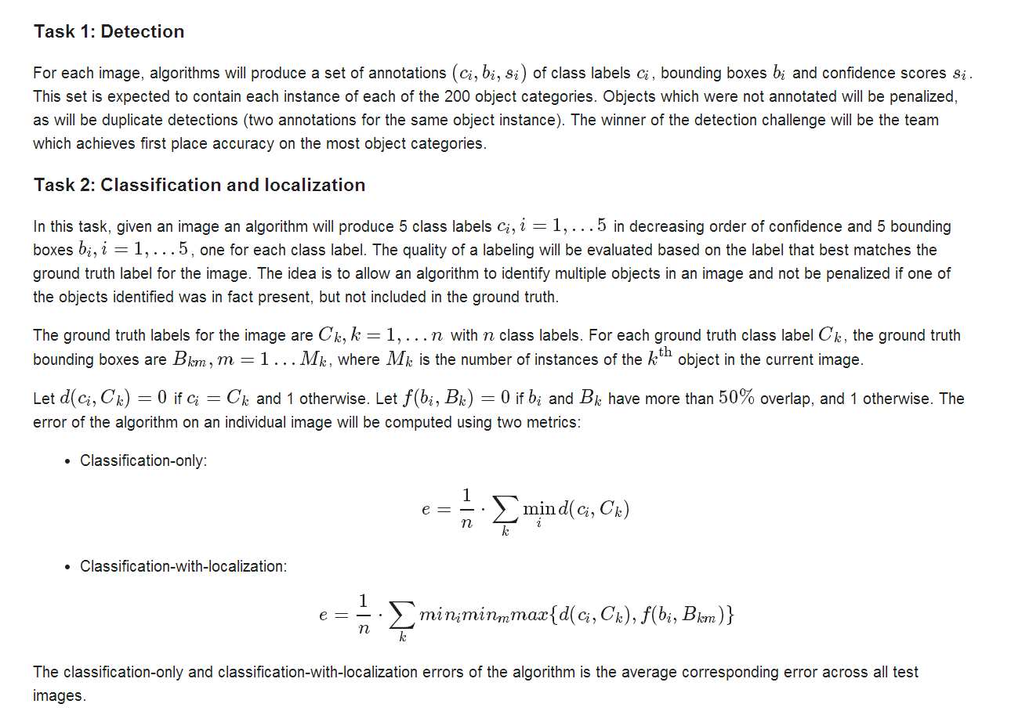
ILSVRC-2014

Slide 5
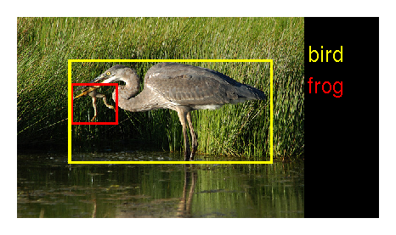
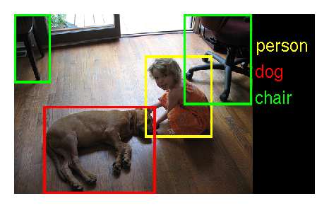
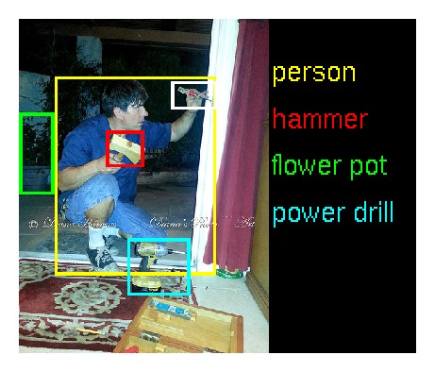
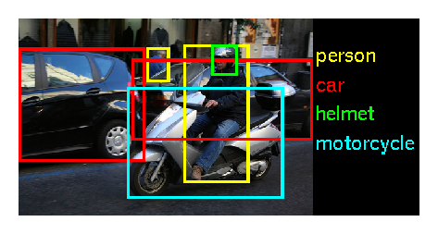
Detection: Examples

Slide 6
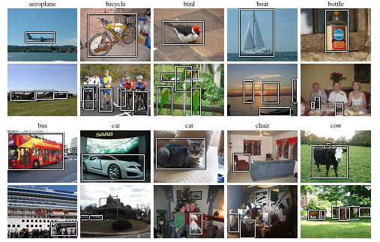
Detection: PASCAL VOC
http://pascallin.ecs.soton.ac.uk/challenges/VOC/
20 classes:

Slide 7
Detection: ILSVRC 2014
http://image-net.org/challenges/LSVRC/2014/
 |  | PASCAL 2012 | ILSVRC 2013 | ILSVRC 2014
 | # classes | 20 | 200 | 200
Training | # images | 5717 | 395909 | 456567
 | # objects | 13609 | 345854 | 478807
Validation | # images | 5823 | 20121 | 20121
 | # objects | 13841 | 55502 | 55502
testing | # images | 10991 | 40152 | 40152
 | # objects

Slide 8
Detection paradigms
Overfeat
Regions with CNN
SPP + CNN
CNN + Regression

Slide 9
Overfeat

Slide 10
Overfeat: Integrated classification, localization & detection
http://cilvr.nyu.edu/doku.php?id=software:overfeat:start
Training a convolutional network to simultaneously classify, locate and detect objects. 3 ideas:
apply a ConvNet at multiple locations in the image, in a sliding window fashion, and over multiple scales.
train the system to produce
a distribution over categories for each window,
a prediction of the location and size of the bounding box containing the object relative to that of the viewing window
accumulate the evidence for each categories at each location and size.

Slide 11
Overfeat: “accurate” net topology
input 3x221x221
convo: 7×7 stride 2×2; ReLU; maxpool: 3×3 stride 3×3; output: 96x36x36
convo: 7×7 stride 1×1; ReLU; maxpool: 2×2 stride 2×2; output: 256x15x15
convo: 3×3 stride 1×1 0-padded; ReLU; output: 512x15x15
convo: 3×3 stride 1×1 0-padded; ReLU; output: 512x15x15
convo: 3×3 stride 1×1 0-padded; ReLU; output: 1024x15x15
convo: 3×3 stride 1×1 0-padded; ReLU; maxpool: 3×3 stride 3×3; output: 1024x5x5
convo: 5×5 stride 1×1; ReLU; output: 4096x1x1
full; ReLU; output: 4096x1x1
full; output: 1000x1x1
softmax; output: 1000x1x1
Feature Extraction: 3 x [231x231] → 1024 x [5x5], with total down-sampling is (2x3x2x3):1=36:1

Slide 12
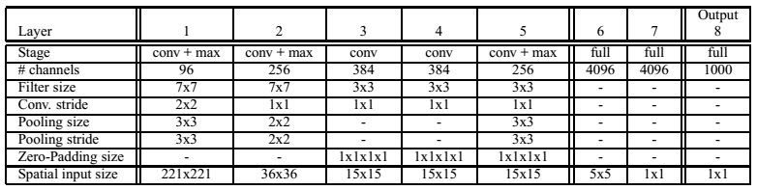
Overfeat: topology summary
Layers 1-5 are similar to Alexnet: conv. layer with ReLU, and max pooling, but with the following differences:
no contrast normalization
pooling regions are non-overlapping
Smaller stride to improve accuracy

Slide 13
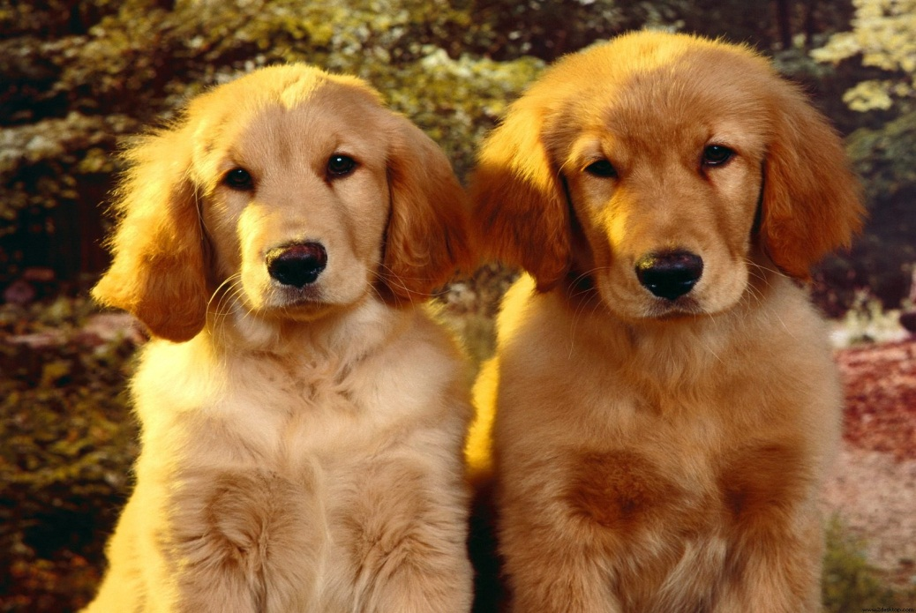
Overfeat: classification
Let’s takes image, and apply sliding window [231x231], For each window we will take best score. Feature extractor has sub-smapling 36:1. If we slide window with step 36, then output feature will slide with step 1
231x231
5x5
5x5
Image: 340x270
Features: 8x6
Best score: 4x2

Slide 14
Overfeat: classification
2 adjacent windows share many computations. Let’s do all windows in parallel.
Feature extraction:
The filters are convolved across the entire image in one pass. This far more efficient than sliding a fixed-size feature extractor over the image and then aggregating the results from different locations.
Classifier :
Two last fully connected layers can be done in parallel too, but we should take care of right offsets.

Slide 15
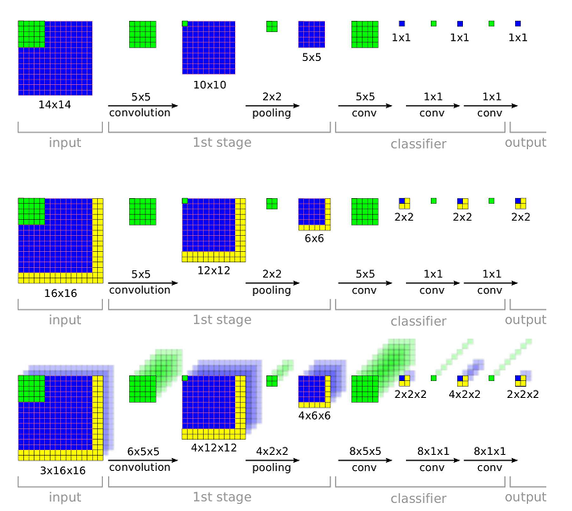
Overfeat: classification

Slide 16
Overfeat: classification
Feature Extraction:
we compute first 5 layers for whole image. First 5 layers before pooling correspond to 12:1 “subsampling” .
Classifier:
The classifier has a fixed-size 5x5 input and is exhaustively applied to the layer 5 maps. We will shift the classifier’s viewing window by 1 pixel through pooling layers without subsampling.
In the end we have [MxN] x C scores, where M, N are sliding windows index, and C – number of classes.
Quiz: How to choose 5 best options?
Input | Layer 5 Before pooling | Layer 5 After pool 3x3 | Classifier map
245x245 | 17x17 | [3x3] x [5x5] | [3x3] x C
281x 317 | 20x23 | [6x9] x [5x5] | [6x9] x C

Slide 17
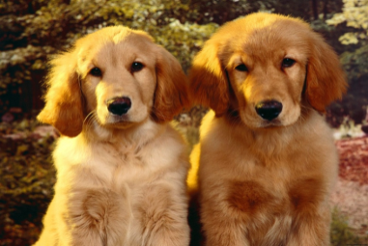

Overfeat: scaling and data augmentation
To locate objects in different sizes we can rescale image to 6 scales:
The typical ratio from one scale to another is about ~1.4 (this number differs for each scale since dimensions are adjusted to
fit exactly the stride of our network)
Data augmentation: horizontal flipping.
Final post-processing:
For each class we took local spatial max for resulting windows,
take top-1/ top-5 .

Slide 18
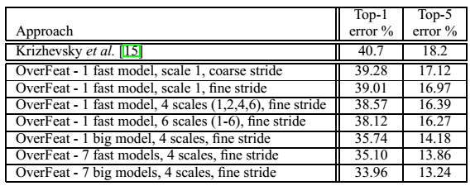
Overfeat: boosting
Boosting: train 7 different models with different init weights, and select the best result

Slide 19
Overfeat: ”fast” net topology
Input 3x231x231
convo: 11×11 stride 4×4; ReLU; maxpool: 2×2 stride 2×2; output: 96x24x24
convo: 5×5 stride 1×1; ReLU; maxpool: 2×2 stride 2×2; output: 256x12x12
convo: 3×3 stride 1×1 0-padded; ReLU; output: 512x12x12
convo: 3×3 stride 1×1 0-padded; ReLU; output: 1024x12x12
convo: 3×3 stride 1×1 0-padded; ReLU; maxpool: 2×2 stride 2×2; output: 1024x6x6
convo: 6×6 stride 1×1; ReLU; output: 3072x1x1
full; ReLU; output : 4096x1x1
full; output: 1000x1x1
softmax; output: 1000x1x1

Slide 20
Overfeat : training details
Data augmentation:
Each image is down-sampled so that the smallest dimension is 256 pixels. We then extract 5 random crops (and their horizontal flips) of size 221x221 pixels
Weight initialization
randomly with (µ, σ) = (0, 1 × 10 ⁻² ).
Training:
SGD with learning rate = 5 × 10⁻² and is decreased by ½ after (30, 50, 60, 70, 80) epochs,
momentum =0.6 ,
ℓ₂ weight decay =1×10⁻⁵ ;
Dropout in FC layers.

Slide 21
Overfeat: localization
Starting from our classification-trained network, fix the feature extraction layers (1-5) and replace the classifier layers by a regression network:
Regression net takes as input the pooled feature maps from layer 5. It has 2 fully-connected hidden layers of size 4096 and 1024 channels, respectively. The output layer: has 4 units for each class, which specify the coordinates for the bounding box edges.
Train regression net:
using an ℓ₂ loss between the predicted and true bounding box for each example.
training use the same set of scales as in multi-scale classification.
compare the prediction of the regressor at each spatial location with the ground-truth bounding box, shifted into the frame of reference

Slide 22
Overfeat: localization
Bounding boxes are merged & accumulated
Assign to C_{s} the set of classes in the top -5 for each scale s ∈ 1 . . . 6, by taking the maximum detection class outputs across spatial locations for that scale.
Assign to B_{s} the set of bounding boxes predicted by the regressor network for each class in C_{s}, across all spatial locations at scale s.
Assign B ←U_{s} B_{s}
Repeat merging until done:
(b1, b2) = argmin _{b1!= b2∈B} match_score (b1, b2)
If (match_score(b1, b2) > t), then stop;
Otherwise, set B ← B\ {b1, b2} ∪ box_merge(b1, b2)
Here match_score = the sum of the distance between centers of the two bounding boxes and the intersection area of the boxes.
box merge compute the average of the bounding boxes’ coordinates.

Slide 23
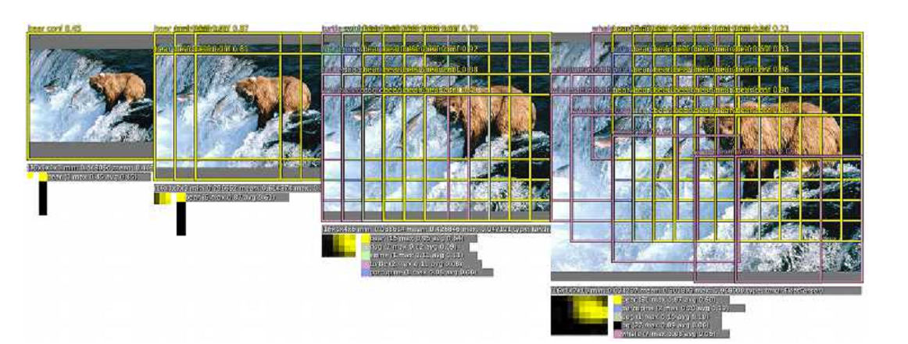
Overfeat: localization pipleine
The raw classifier/detector outputs a class and a confidence for each location:

Slide 24
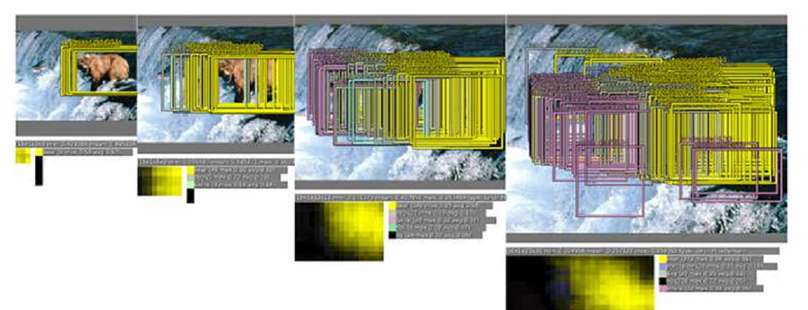
Overfeat: localization pipleine
The regression then predicts the location scale of the object with respect to each window:

Slide 25
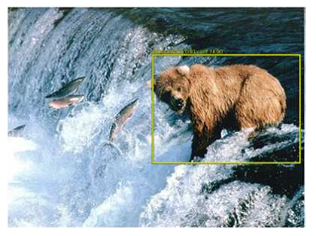
Overfeat: localization pipleine
Bounding boxes are merged & accumulated

Slide 26
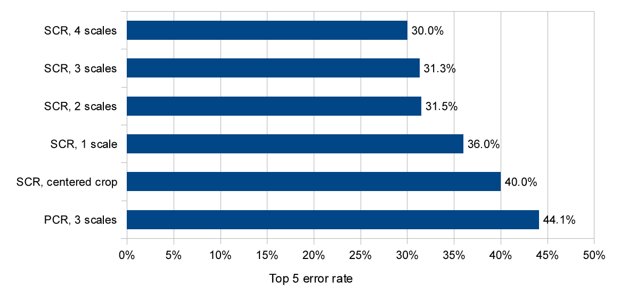
Single-class Regression vs Per- Class Regression
Using a different top layer for each class in the regressor network for each class (Per-Class Regressor (PCR) surprisingly did not outperform using only a single network shared among all classes (44.1% vs. 31.3%).

Slide 27
Overfeat: Detection
The detection task differ from localization in that there can be any number of object in each image (including zero), and that false positives are penalized by the mean average precision (mAP) measure
The main difference with the localization task, is the necessity to predict a background class when no object is present. Traditionally, negative examples are initially taken at random for training. Then the most offending negative errors are added to the training set in bootstrapping passes.

Slide 28
Regions with CNN

Slide 29
R-CNN: Regions with CNN features
R. Girshick et al , Berkeley “Rich feature hierarchies…”
http://www.cs.berkeley.edu/~rbg/slides/rcnn-cvpr14-slides.pdf
Source: https://github.com/rbgirshick/rcnn // requires Matlab
Regions with CNN detection approach:
generates ~2000 category-independent regions for the input image,
extracts a fixed-length feature vector from each region using a CNN,
classifies each region with category-specific linear SVM
R-CNN outperforms OverFeat, with a mAP = 31.4% vs 24.3%.

Slide 30
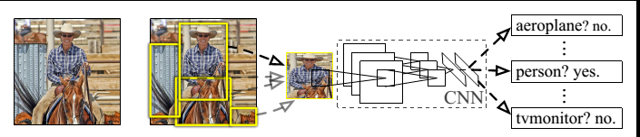
R-CNN: architecture
Region detection → 2000 regions , see http://www.eecs.berkeley.edu/Pubs/TechRpts/2012/EECS-2012-124.pdf
Region croped and scaled to [227 x 227] ➔ feature extraction with Imagenet: 5 convolutional layers + 2FC ➔ 4096 features
SVM for 200 classes
Greedy non-maximum suppression for each class: rejects a region if it has an intersection-over-union (IoU) overlap with a higher scoring selected region larger than a learned threshold

Slide 31
R-CNN Training
The principle idea is to train feature extraction CNN on a large auxiliary dataset (ILSVRC), followed by domain specific fine-tuning on a small dataset (PASCAL):
Pre-training: Train Imagenet
Replace last layer with FC layer to N+1 outputs (N classes + 1 “background”; VOC N=20, ILSVRC N=200 )
Training:
For each region: if IoU > ½ - positive example, otherwise – negative (background).
Batch = 128 = 32 positive + 96 background
Init weights random
SGD with λ= 0.001

Slide 32
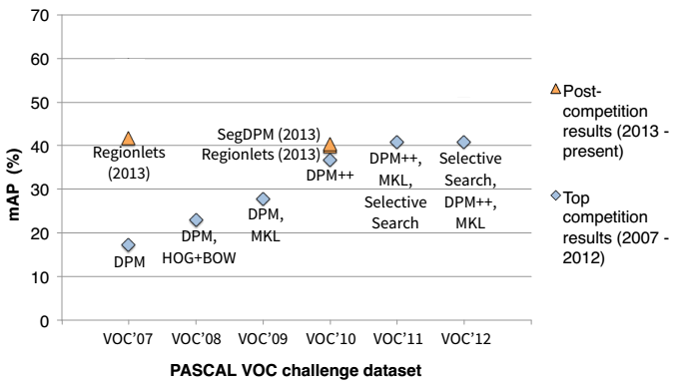
R-CNN: PASCAL VOC performance
2012 SIFT, HOG,…

Slide 33
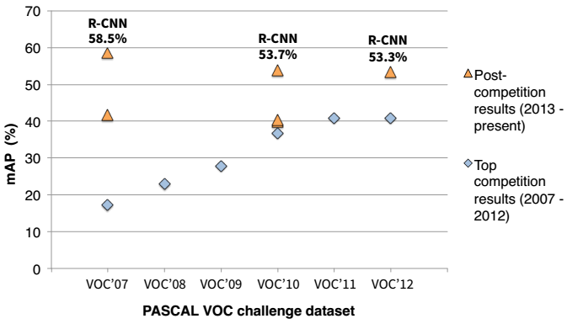
R-CNN: PASCAL VOC performance
2014: Regions with CNN

Slide 34
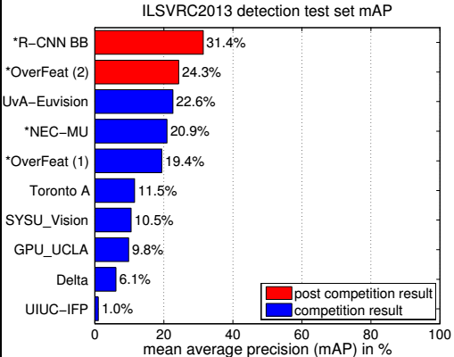
R-CNN: ILSVRC 2013 performance

Slide 35
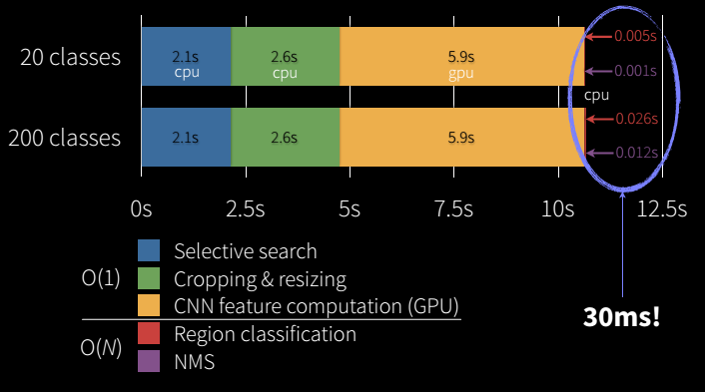
R-CNN speed and
R-CNN detection time/frame

Slide 36
R-CNN CODE
https://github.com/rbgirshick/rcnn
Requires Matlab!

Slide 37
CNN with Spatial Pyramid pooling

Slide 38
SPP-net = CNN + SPP
Kaiming He et al, “Spatial Pyramid Pooling in Deep Convolutional Networks for Visual Recognition
“Classical” conv. NN” requires a fixed-size (e.g. 224224) input image:
Need cropping or warping to transform original image to square shape
This constraint is related to Fully-Connected layer ONLY
Idea: let’s use Spatial Pooling Pyramid to transform any-shape image to ‘fixed-length” feature vector.
http://research.microsoft.com/en-us/um/people/kahe/

Slide 39
CNN topology
FORWARD
Soft Max
BACKWARD
Inner Product
ReLUP
Inner Product
Pooling [2x2, stride 2]
SPP(5x5+7x7+13x13)
Convolutional layer [5x5]
Pooling [2x2, stride 2]
Convolutional layer [5x5]
Data Layer

Slide 40
Spatial Pyramid Pooling
Here sizeX is the size of the pooling window. This configuration is for a network whose feature map size of conv5 is 1313, so the pool₃₃, pool₂₂, and pool₁₁ layers will have 3x3, 2x2, and x1 bins respectively.

Slide 41
SPP-net training
Size augmentation:
Imagenet: 224x224 → 180x180
Horizontal flipping
Color altering
Dropout with 2 last FC layers
Learning rate:
Init lr= 0.01; divide by 10 when error plateau

Slide 42
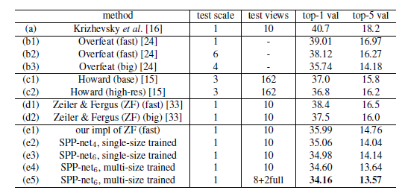
SPP-net: Imagenet classification

Slide 43
SPP: Imagenet - Detection
Find 2000 windows candidate /~ R-CNN /
extract the feature maps from the entire image only once (possibly at multiple scales) /~ Overfeat/.
Then apply the spatial pyramid pooling on each candidate window of the feature, which maps window to a fixed-length representation
Then 2 FC layers
SVM
~170x faster than R-CNN

Slide 44
Exercises & Projects
Exercise:
Implement Overfeat network; train classifier.
Projects:
Install R-CNN
Re-implement R-CNN in pure Python/C++ to eliminate Matlab dependency

Slide 45
CNN - Regression
BACKUP

Slide 46
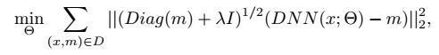
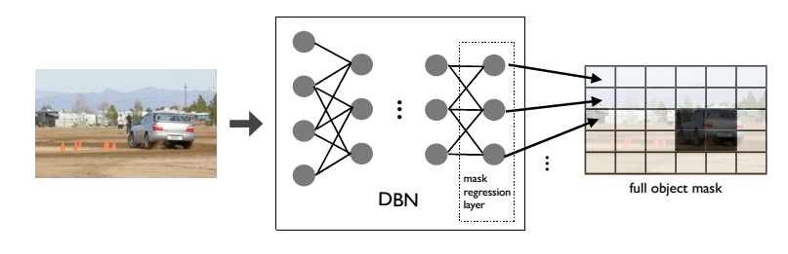
CNN regression
Szegedy et all ( Google) 2010, “Deep Neural Networks for Object Detection”
start with Alexnet,
replace last soft-max layer with regression layer which generates an binary mask “d x d” : 1 if pixel is inside box, 0- otherwise;
train net by minimizing L₂ error vs ground truth mask m:

Slide 47
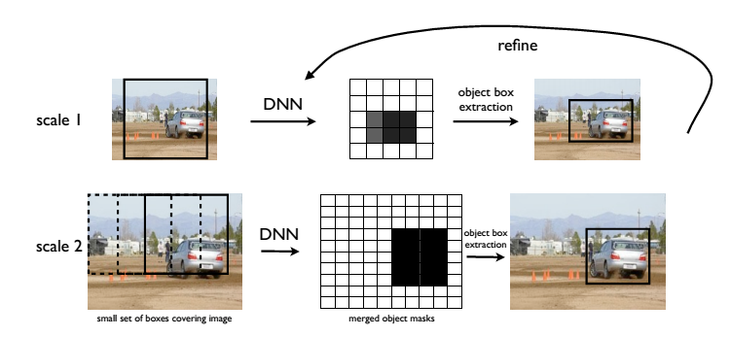
CNN regression
Multi-scale

Slide 48
CNN regression
Issues:
Overlapping masks for multiple touching objects
Localization accuracy
Recognition of small objects
Issue1:
To deal with multiple touching objects, we generate not one but several masks, each representing either the full object or part of it.
we use one network to predict the object box mask and four additional networks to predict four halves of the box: bottom, top, left and right halves

